Slide 1
UVic Technology Solutions Centre
The Standardization of PC Acquisition and Support

Slide 2
Introduction
Session
  50 minutes
  What, why, and how of the UVic TSC
Speaker
  Nav Bassi, BSc, MBA, PMP
  Director, Academic & Admin Services

Slide 3
The Problem
People buying whatever they want
  Mixture of consumer/commercial hardware
  Home-based operating systems
  Poor warranty service
  Expensive one-off purchases
University supporting everything they buy
  Unpleasant surprises/tech review confrontation
  Inconsistent experience

Slide 4
A Potential Solution
Develop standards
Guarantee level of performance/compatibility of standards
Get a good deal from a vendor
  Price discounts
  Warranty service
  Quick delivery

Slide 5
First Attempt
Write an RFP for a vendor to do it all
  Hardware/software specifications
  Ordering system
  Delivery
  On-site support

Slide 6
The Insight
In order to make this work, we needed a parallel to the vendor on campus to facilitate the ordering process
This is how we add value*, get campus buy-in, and also keep an eye on our vendor
*Especially for non-standard acquisitions; recommend and tech review

Slide 7
Refined Solution
Technology Solutions Centre
  4 published standard PCs; mandatory for VPFO, recommended for all others
  Ordering is done via our WebReq system, TSC passes these on to our vendor
  Delivery is done by the vendor, directly to the client
  On-site support is provided by our staff, or our vendor’s team

Slide 8
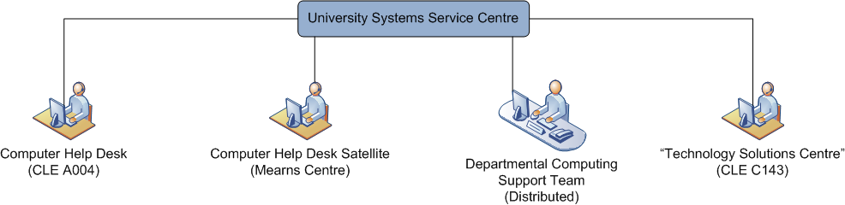
Staffing Model (net: 0)

Slide 9
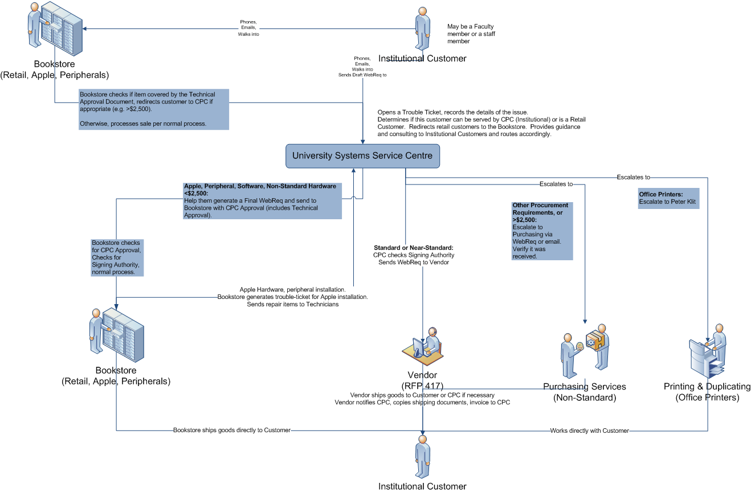
Campus Workflows

Slide 10
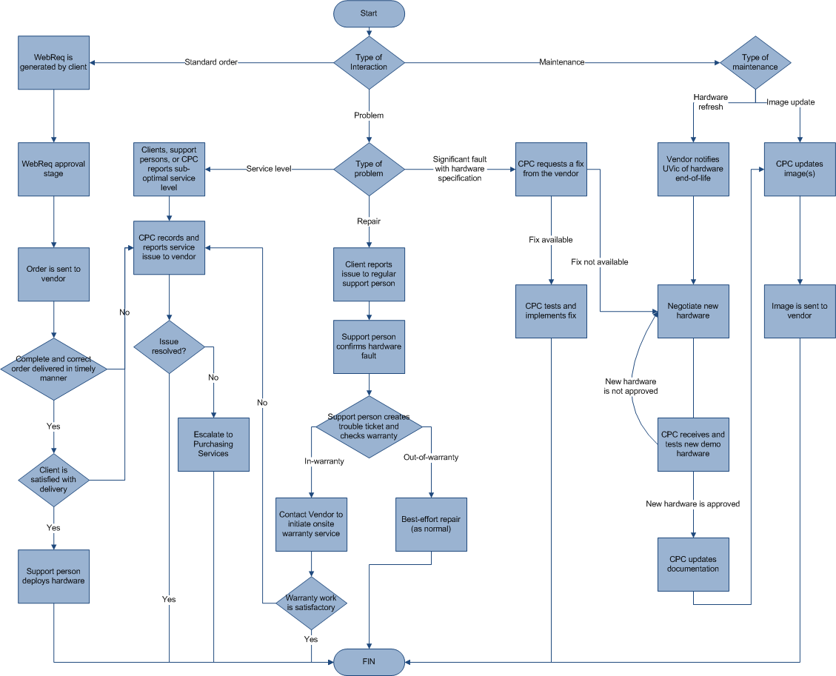
Vendor Interactions

Slide 11
Technology Solutions Centre
Technology Solutions Centre is where our campus clients go
  If the standard works for you, no direct interaction is required
  Otherwise, you can phone, email, or walk-in for assistance
http://www.uvic.ca/tsc

Slide 12
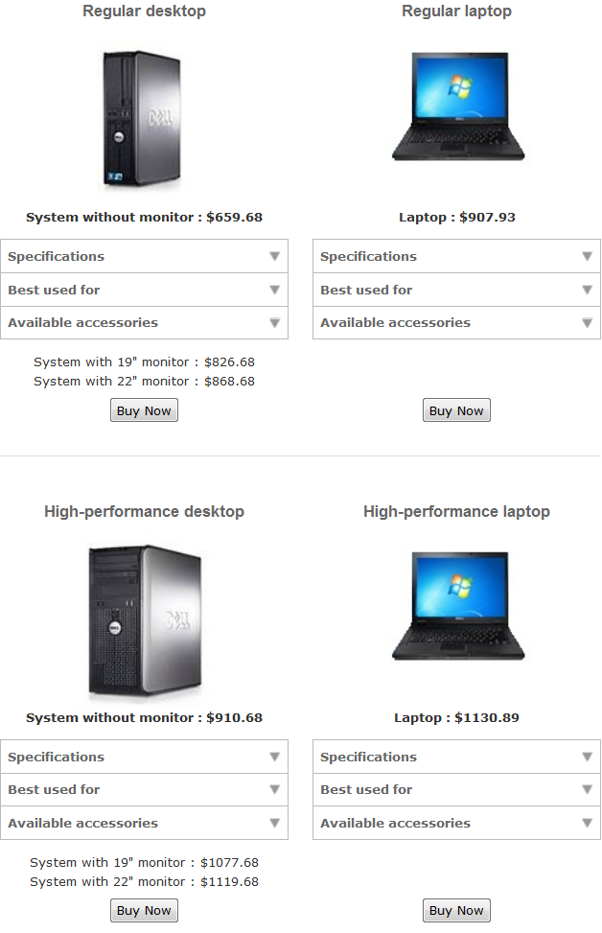

Slide 13
“Standard” since July 1, 2010
Standard PC Acquisitions: | Quantity | Retail Cost | TSC Cost | Savings
Regular desktops | 218 | $ 1,074.00 | $ 552.00 | $ 113,796.00
High-performance desktops | 368 | $ 1,666.00 | $ 804.00 | $ 317,216.00
Regular laptops | 41 | $ 1,613.00 | $ 819.00 | $ 32,554.00
High-performance laptops | 95 | $ 1,903.00 | $ 1,026.00 | $ 83,315.00
22” monitors | 328 | $ 279.00 | $ 220.00 | $ 19,352.00
19” monitors | 181 | $ 239.00 | $ 167.00 | $ 13,032.00
 | Total Savings: |  |  | $579,265.00

Slide 14
“Non-Standard” since July 1, 2010
 | Quantity | Retail Cost | TSC Cost | Savings
Ultra portable high-performance laptop | 11 | $ 2,732.00 | $ 1,839.38 | $ 9,818.82
Ultra Light netbook | 14 | $ 399.00 | $ 379.00 | $ 280.00
Non-standard workstations | 182 | $ 1,720.00 | $ 1,100.00 | $ 112,840.00
 | Total Savings: |  |  | $122,938.82

Slide 15
Total Savings Over Retail Pricing Since July 1, 2010
$702,203.82

Slide 16
How busy is the TSC?
Activity | April 2011 | Since July 1, 2010
Emails received | 508 | 5,173
Standard Web Requisitions | 73 | 514
Non-standard Web Requisitions | 16 | 98
Technical Reviews (per Policy FM5105) | 89 | 663

Slide 17
Total Savings Over Retail Pricing Since July 1, 2010
$702,203.82
With no additional staff

Slide 18
Handling the Hiccups
Macs
  Campus perception
Vendor issues
  Delays/errors
Refunds

Slide 19
Refinements To Date
Technology Solutions Centre Demo Facility
  Standard Dell PCs
  Standard office furniture
  Standard Cisco VoIP phones
  Standard Kyocera office printers
  Macs
Additional internal standards
  Ultra-portable laptop
  Netbook

Slide 20
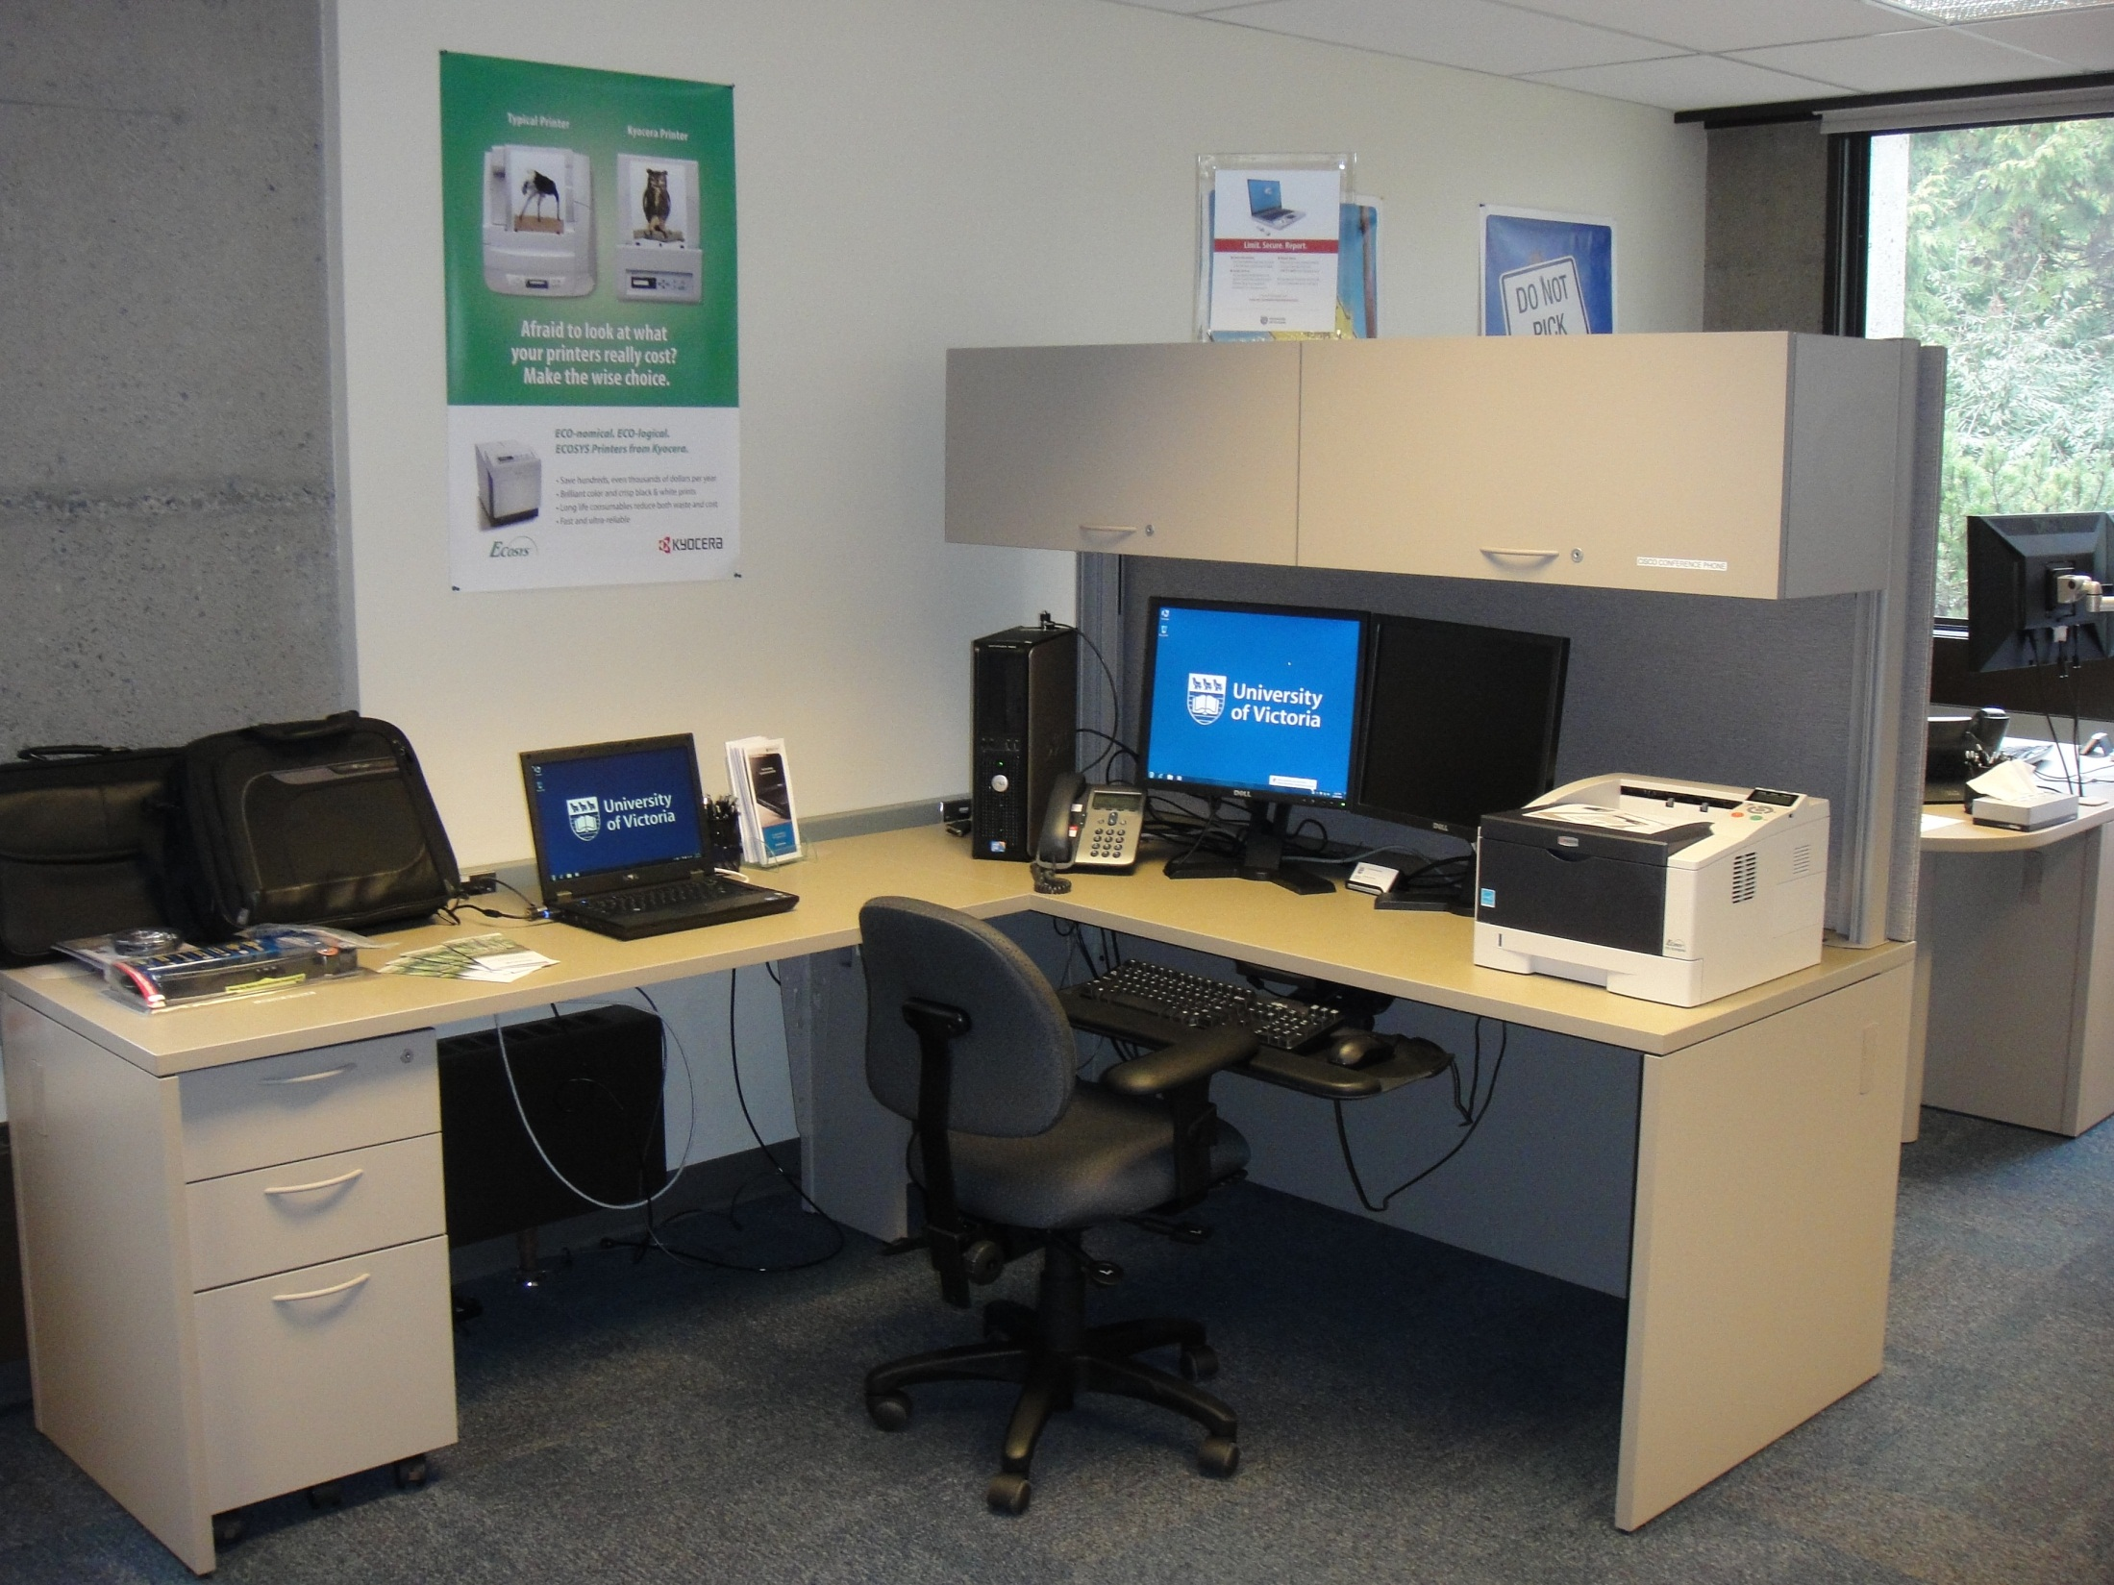

Slide 21
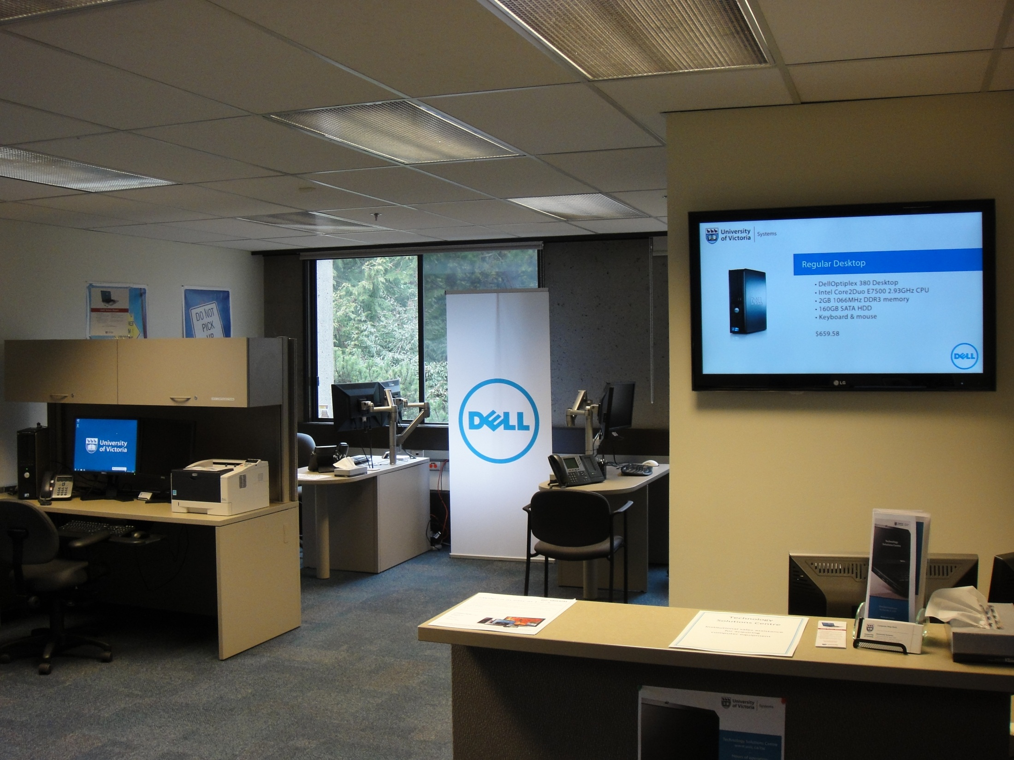

Slide 22
Future Refinements
Additional technology
  Smartboards?
  VDPs?
  Mobile phones?
Finalize Policy/Procedures
  Policy/Procedures drafted
  Exception process for VPFO units

Slide 23

Questions?
Thank you for attending!
Feedback: navbassi@uvic.ca

